Slide 1

COMMUNICATION PACK: COVID-19
As of 9th March 2020

Slide 2

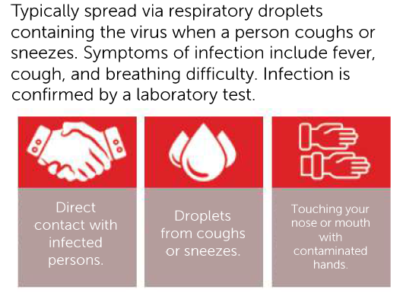
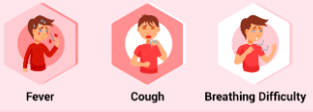

BACKGROUND ON COVID-19
WHAT IS COVID-19 ?
SYMPTOMS
Coronaviruses are a large group of viruses which can impact both humans and animals. The intensity of the infection ranges from common colds to acute respiratory syndrome.
The new strain of coronavirus, called COVID-19 is a novel virus to humans. The information related to disease, including symptoms and means of treatment is limited.
TRANSMISSION
IS THERE A TREATMENT OR VACCINE?

Slide 3
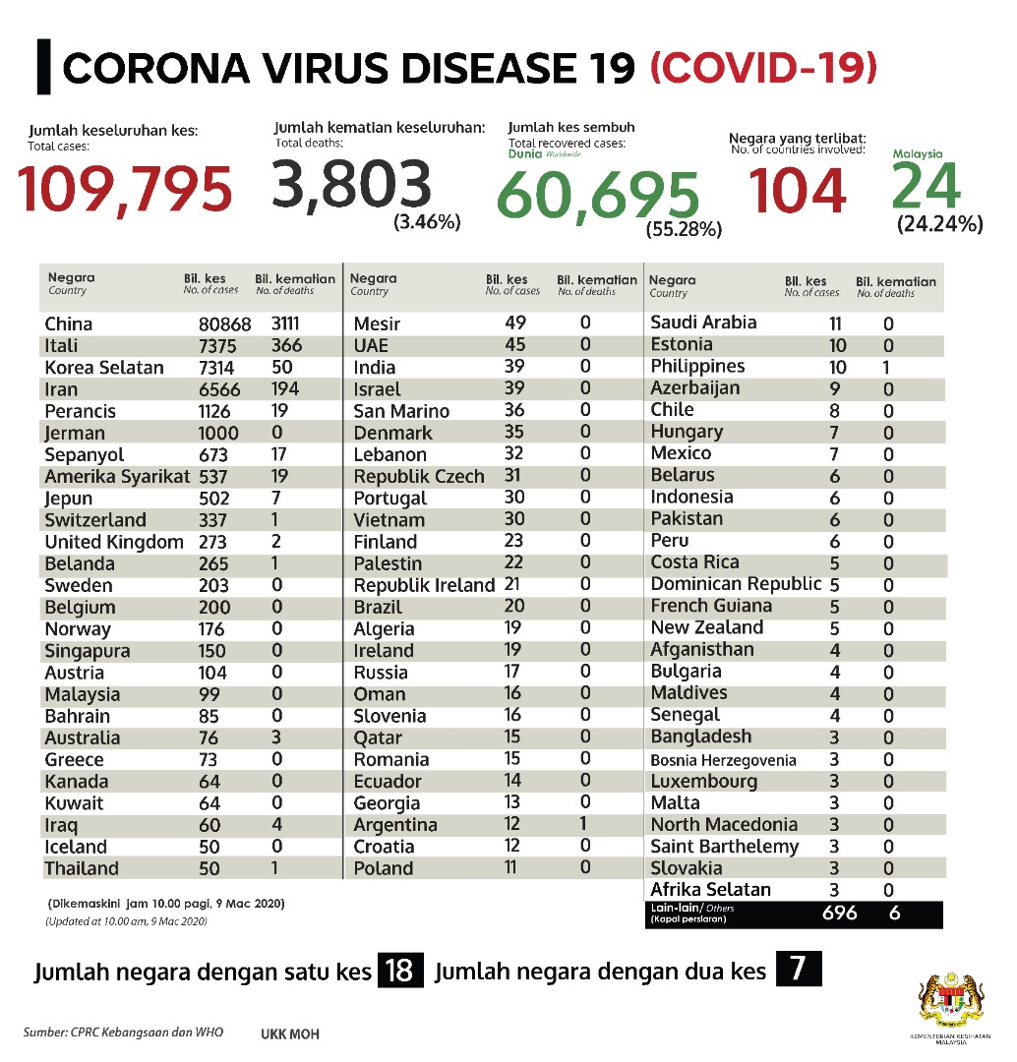
CURRENT SITUATION ON COVID-19
Updated as of 8th March 2020
Source:
http://www.moh.gov.my

Slide 4
WHAT YOU SHOULD DO
TRAVEL ADVISORY
Employees and students are required to POSTPONE ALL BUSINESS/LEISURE TRAVELS TO:
Employees returning from the aforementioned countries (including airport transits), are required to inform HR department and are required to be self-quarantined for 14 calendar days.
Students returning from the aforementioned countries (including airport transits), are required to inform respective department (CSIMAL/Registry/Mobility) and are required to be self-quarantined for 14 calendar days.
Employees and students shall seek immediate medical attention should any symptoms arise (i.e. fever, cough, sore throat or breathing difficulty).
Prior and after business or travel, employees are required to notify COMCEN by phone at +603 23319999 or by email at comcen@petronas.com.my. For students, respective department shall notify COMCEN.
PEOPLE’S REPUBLIC OF CHINA (INCLUDING MAINLAND CHINA, HONG KONG & MACAU), TAIWAN, SOUTH KOREA, JAPAN, ITALY AND IRAN.

Slide 5
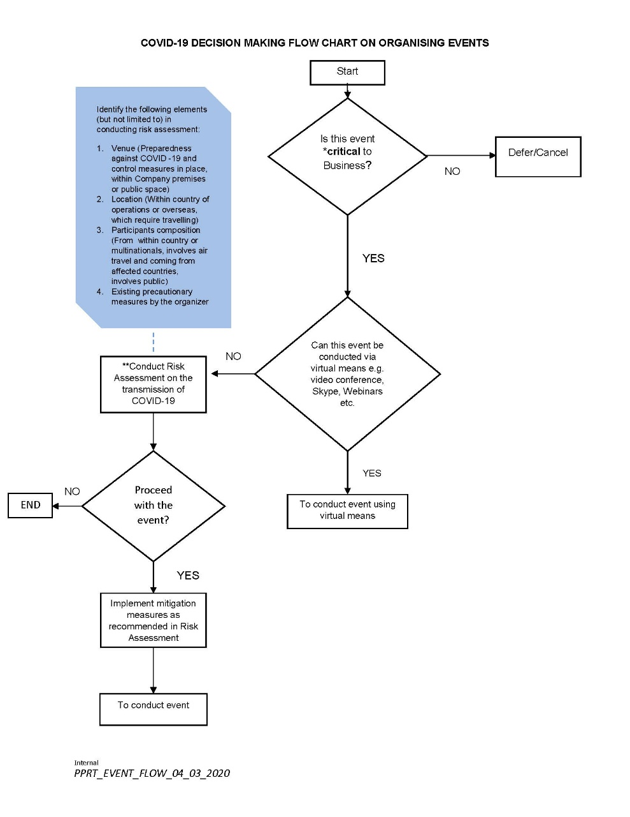
WHAT YOU SHOULD DO
ATTENDING AND ORGANISING EVENTS
Employees to avoid attending and defer organising any form of non-business critical events.
For any critical business events, risk assessment and mitigation measures shall be conducted. The risk assessment shall be endorsed by the respective Head of the Organising Department.
Please refer COVID-19 Decision Making Flow Chart on Organising Events.
If the event organiser decided to proceed with organising the event, it is the event organiser’s responsibility to distribute the health declaration form to the participants, conduct risk assessment, perform temperature screening during the event, and prepare all the PPE required, such as masks and hand sanitiser.

Slide 6
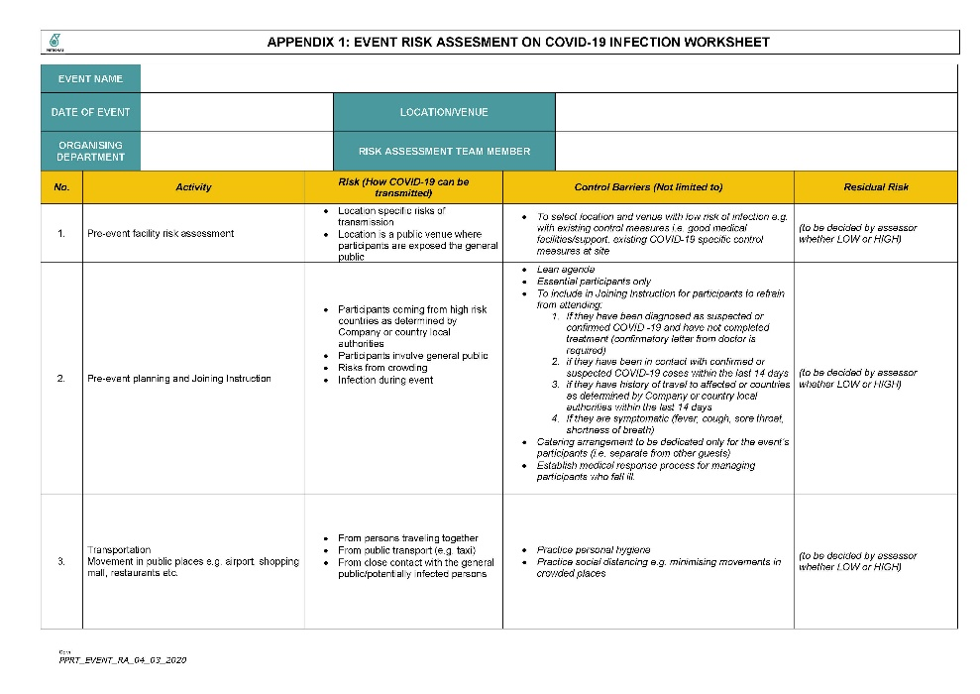
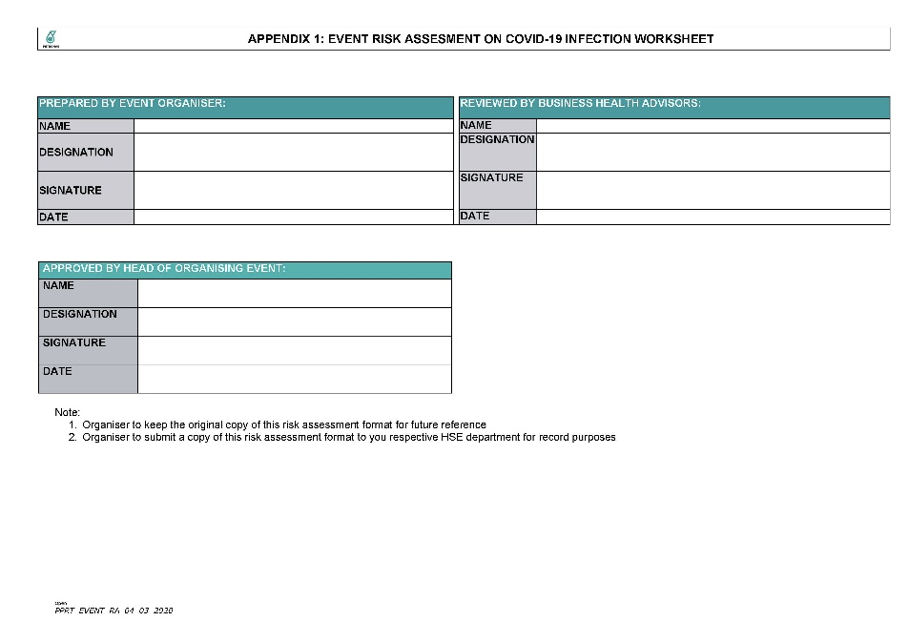
WHAT YOU SHOULD DO
ATTENDING AND ORGANIZING EVENTS
Event is defined as face to face meeting such as staff gatherings for workshops, conferences, team building, away days, seminars, awareness talks and training.
Factors that determine events business criticality are:
  1. Legal violations i.e. if the event is not organised, there will be legal implications to UTP
  2. Impacting license to operate
  3. Personnel health and safety
  4. Operational risk and impact
  5. Environmental impact
  6. Business continuity
  7. Financial loss
  8. Reputation damage
**Risk assessment to be performed using Appendix 1

Slide 7
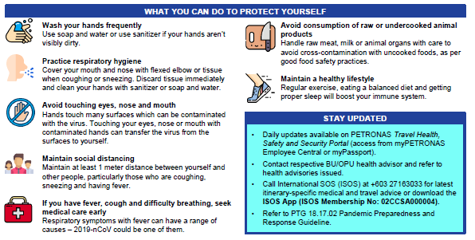
WHAT YOU SHOULD DO

Slide 8



CONTACT US
hse@utp.edu.my
1-300-22-8887
Universiti Teknologi PETRONAS/HSE Dept

Slide 9


THANK
YOU
© 2020 INSTITUTE OF TECHNOLOGY PETRONAS SDN BHD
All rights reserved.
No part of this document may be reproduced, stored in a retrieval system or transmitted in any form or by any means (electronic, mechanical, photocopying, recording or otherwise) without the permission of the copyright owner.

